Slide 1

A self-referential class contains an instance variable that refers to another object of the same class type.
For example, the generic class declaration
    class Node<T>
    {
    private T data;
    private Node<T> nextNode; // reference to next node
    public Node(T data) { /* constructor body */ }
    public void setData(T data) { /* method body */ }
    public T getData() { /* method body */ }
    public void setNext(Node<T> next) { /* method body */ }
    public Node<T> getNext() { /* method body */ }
    } // end class Node<T>
declares class Node, which has two private instance variables—data (of the generic type T) and Node<T> variable nextNode.
© Copyright 1992-2015 by Pearson Education, Inc. All Rights Reserved.

Slide 2
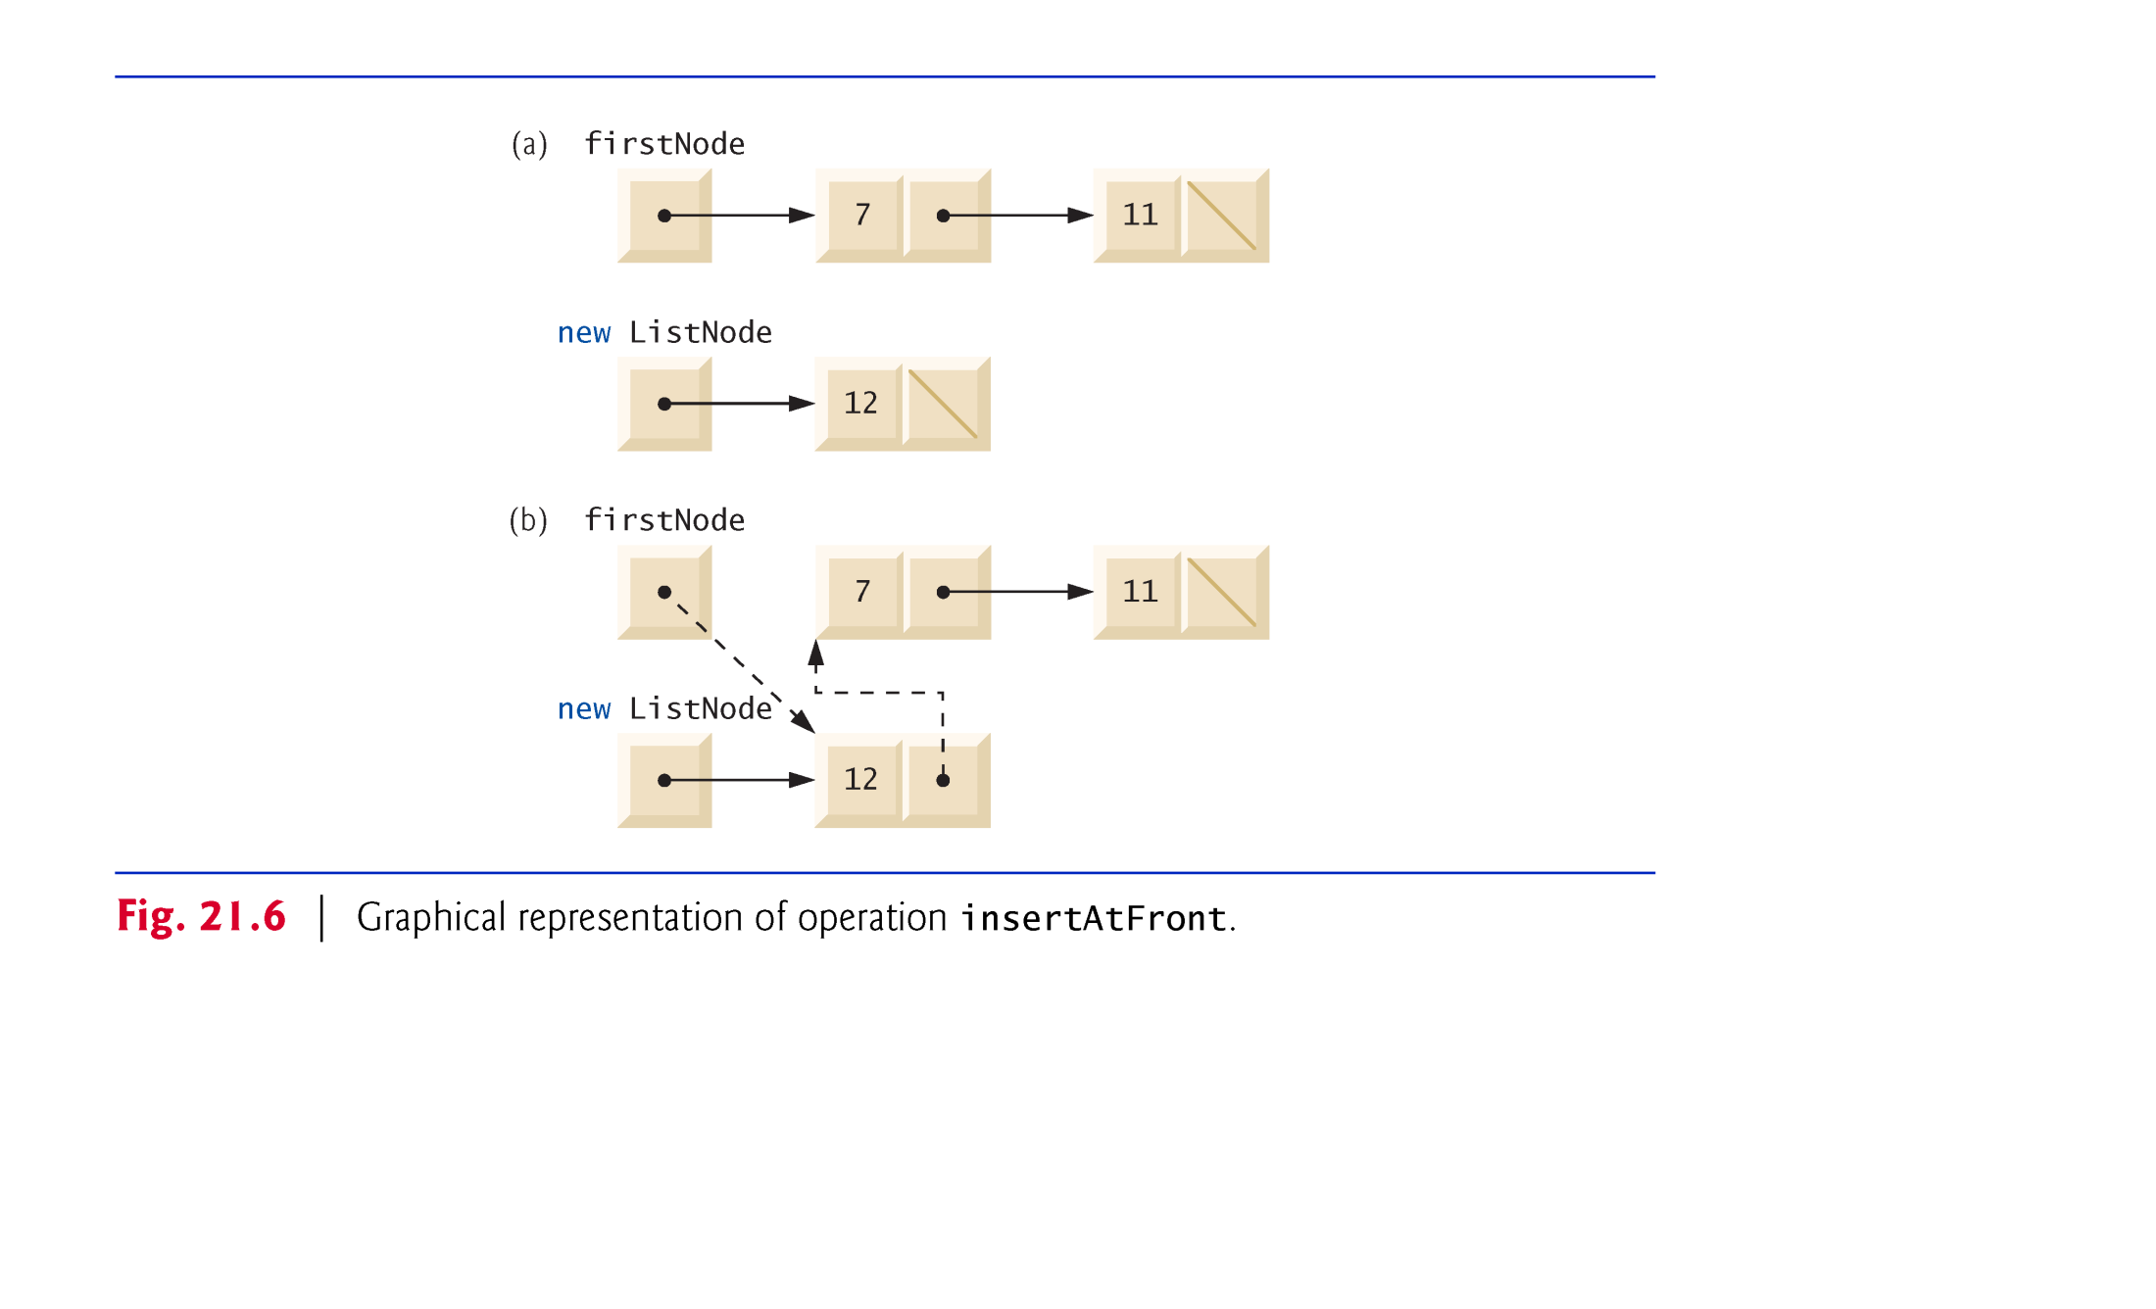
© Copyright 1992-2015 by Pearson Education, Inc. All Rights Reserved.

Slide 3
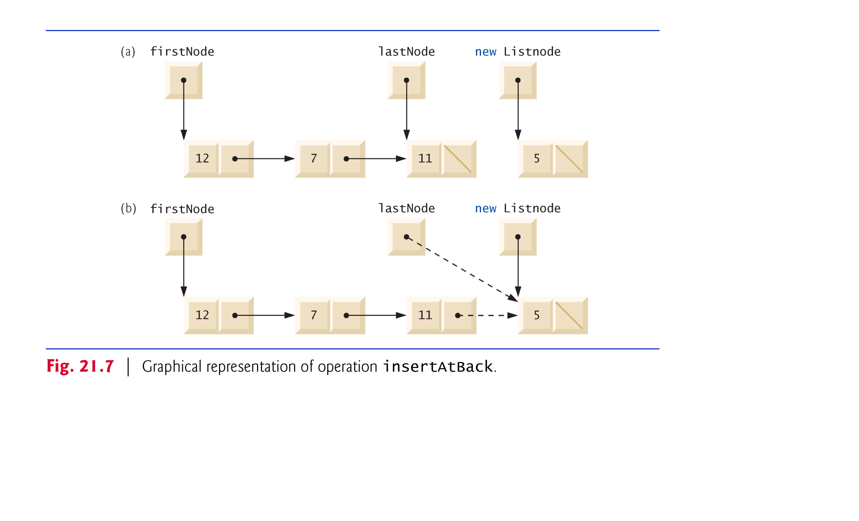
© Copyright 1992-2015 by Pearson Education, Inc. All Rights Reserved.

Slide 4
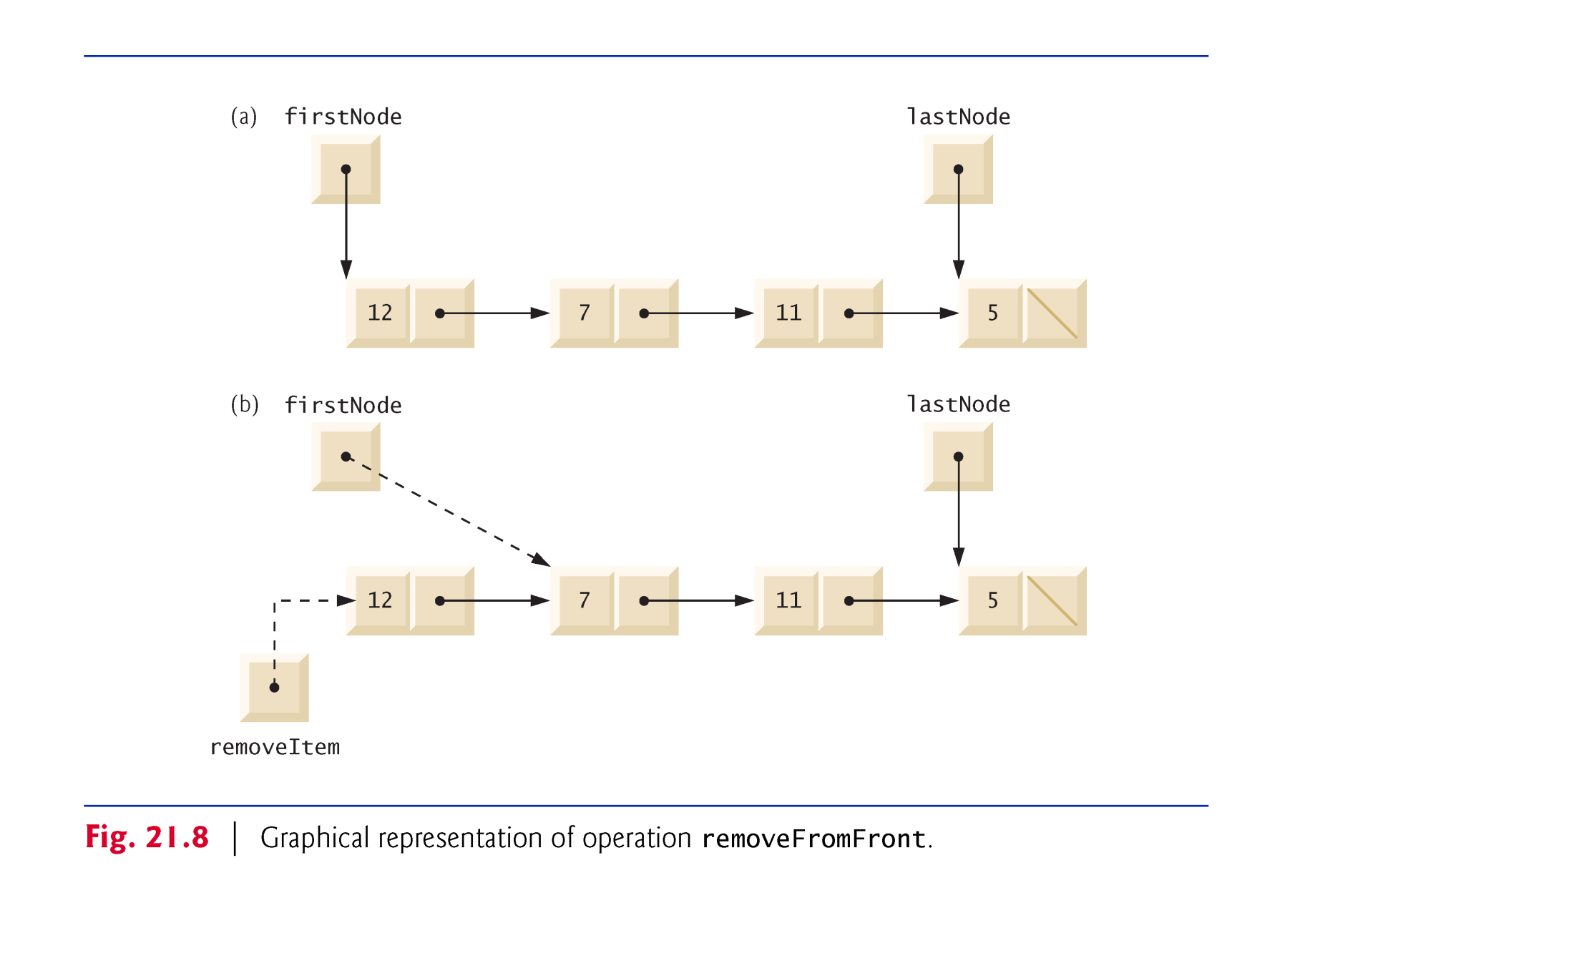
© Copyright 1992-2015 by Pearson Education, Inc. All Rights Reserved.

Slide 5
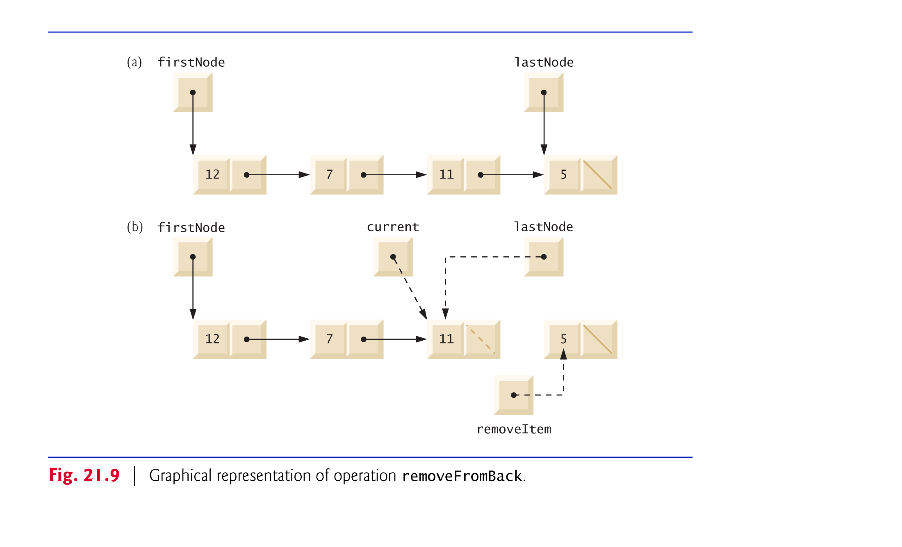
© Copyright 1992-2015 by Pearson Education, Inc. All Rights Reserved.

Slide 6

Singly-Linked List
  Maintains only “forward” references.
  Insert at front or back in O(1) time.
  Remove front front in O(1) time.
  Remove front back in O(n) time.
Doubly-Linked List
  Additional overhead to maintain both “forward” and “backwards” references.
  Insert at front or back in O(1) time.
  Remove from front or back in O(1) time.
© Copyright 1992-2015 by Pearson Education, Inc. All Rights Reserved.

Slide 7

A tree is a nonlinear, two-dimensional data structure with special properties.
Tree nodes contain two or more links.
Binary tree nodes each contain two links (one or both of which may be null).
The root node is the first node in a tree.
Each link in the root node refers to a child.
The left child is the first node in the left subtree (also known as the root node of the left subtree), and the right child is the first node in the right subtree (also known as the root node of the right subtree).
The children of a specific node are called siblings.
A node with no children is called a leaf node.
Computer scientists normally draw trees from the root node down—the opposite of the way most trees grow in nature.
© Copyright 1992-2015 by Pearson Education, Inc. All Rights Reserved.

Slide 8
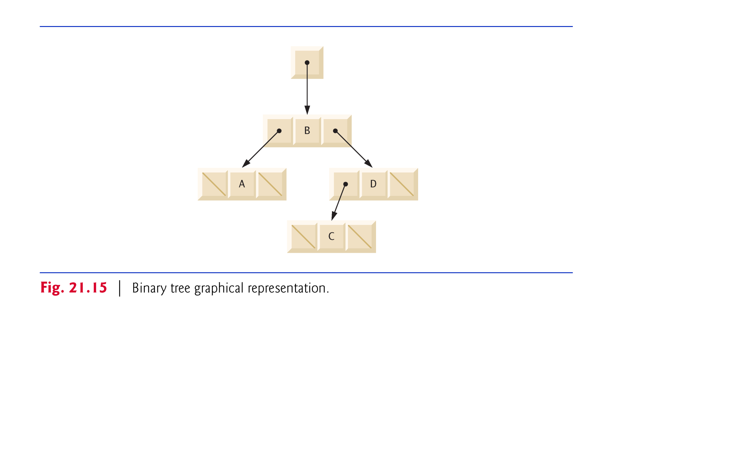
© Copyright 1992-2015 by Pearson Education, Inc. All Rights Reserved.

